Slide 1
CHAPTER 3 Algorithms
3.1 Algorithms
3.2 The Growth of Function (函数的增长率)
3.3 Complexity of Algorithms
1

Slide 2
The Complexity of Algorithms
Given an algorithm, how efficient is this algorithm for solving a problem given input of a particular size? To answer this question, we ask:
How much time does this algorithm use to solve a problem?
How much computer memory does this algorithm use to solve a problem?
When we analyze the time the algorithm uses to solve the problem given input of a particular size, we are studying the time complexity of the algorithm.
When we analyze the computer memory the algorithm uses to solve the problem given input of a particular size, we are studying the space complexity of the algorithm.

Slide 3
Different types of analysis
3.3 Complexity of Algorithms
Worst-case analysis
- Maximum number of operations
- Is a guarantee over all inputs of a given size
Best-case analysis
- Minimum number of operations
- Not very practical
Average-case analysis
- Average number of operations assuming an input probability distribution
- An average over all the possible inputs of a given size
- Can be complicated

Slide 4
3.3 Complexity of Algorithms
Complexity Analysis of Algorithms
ALGORITHM 1 Finding the Maximum Element in
a Finite Sequence.
Procedure max( : integers)
max : =
For i : = 2 to n
If max then max
{ max is the largest element}
〖Example 1〗Describe the time complexity of algorithm for finding the maximum element in a set.
Solution: Count the number of comparisons.
The max < a_{i} comparison is made n − 1 times.
Each time i is incremented, a test is made to see if i ≤ n.
One last comparison determines that i > n.
Exactly 2(n − 1) + 1 = 2n − 1 comparisons are made.
Hence, the time complexity of the algorithm is Θ(n).

Slide 5
3.3 Complexity of Algorithms
ALGORITHM 2 The Linear Search Algorithm.
Procedure linear search (x: integer, : distinct integers)
i : = 1
While ( )
i : = i+ 1
if then location : = i
else location : = 0
{location is the subscript of term that equals x ,or is 0 if x
is not found}
a
,
a
,
L
,
a
1
2
n
〖Example 2〗Describe the time complexity of linear search algorithm.
Solution: Count the number of comparisons.
At each step two comparisons are made; i ≤ n and x ≠ ai .
To end the loop, one comparison i ≤ n is made.
After the loop, one more i ≤ n comparison is made.
If x = ai , 2i + 1 comparisons are used. If x is not on the list, 2n + 1 comparisons are made and then an additional comparison is used to exit the loop. So, in the worst case 2n + 2 comparisons are made. Hence, the complexity is Θ(n).

Slide 6
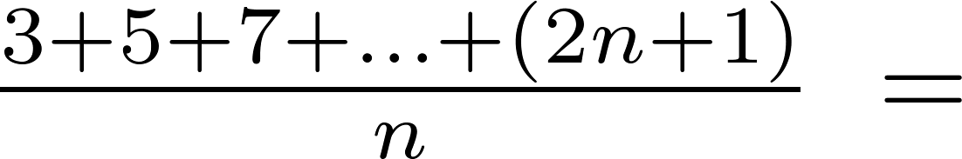
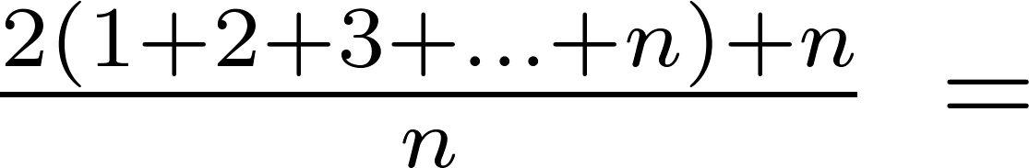
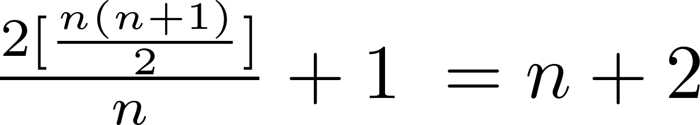
Average-Case Complexity of Linear Search
Example: Describe the average case performance of the linear search algorithm. (Although usually it is very difficult to determine average-case complexity, it is easy for linear search.)
Solution: Assume the element is in the list and that the possible positions are equally likely. By the argument on the previous slide, if x = a_{i} , the number of comparisons is 2i + 1.
Hence, the average-case complexity of linear search is Θ(n).

Slide 7
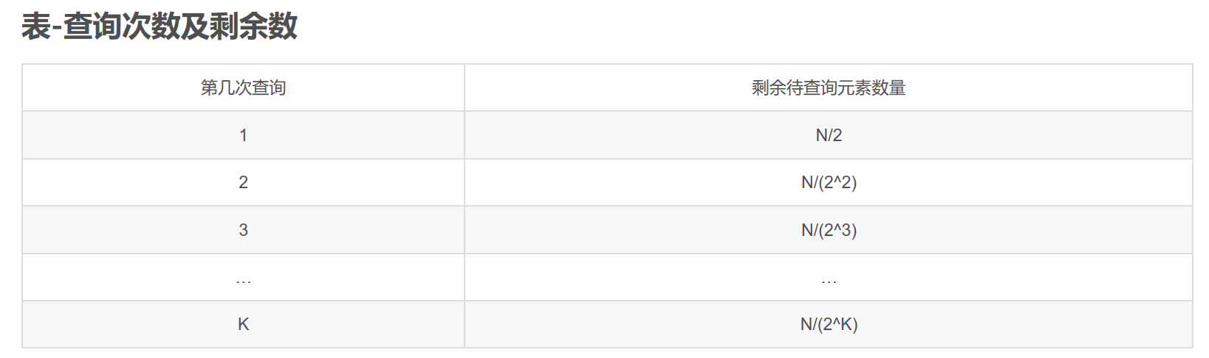
Worst-Case Complexity of Binary Search
Example: Describe the time complexity of binary search in terms of the number of comparisons used.
procedure binary search(x: integer, a₁,a₂,…, a_{n}: increasing integers)
i := 1 {i is the left endpoint of interval}
j := n {j is right endpoint of interval}
while i < j
m := ⌊(i + j)/2⌋
if x > a_{m} then i := m + 1
else j := m
if x = a_{i} then location := i
else location := 0
return location{location is the subscript i of the term a_{i} equal to x, or 0 if x is not found}

Slide 8
Worst-Case Complexity of Binary Search
Example: Describe the time complexity of binary search in terms of the number of comparisons used.
procedure binary search(x: integer, a₁,a₂,…, a_{n}: increasing integers)
i := 1 {i is the left endpoint of interval}
j := n {j is right endpoint of interval}
while i < j
m := ⌊(i + j)/2⌋
if x > a_{m} then i := m + 1
else j := m
if x = a_{i} then location := i
else location := 0
return location{location is the subscript i of the term a_{i} equal to x, or 0 if x is not found}
Solution: Assume (for simplicity) n = 2^{k} elements. Note that k = log n.
Two comparisons are made at each stage; i < j, and x > a_{m} .
At the first iteration the size of the list is 2^{k} and after the first iteration it is 2^{k-1}. Then 2^{k-2} and so on until the size of the list is 2¹ = 2.
At the last step, a comparison tells us that the size of the list is the size is 2⁰ = 1 and the element is compared with the single remaining element.
Hence, at most 2k + 2 = 2 log n + 2 comparisons are made.
Therefore, the time complexity is Θ (log n), better than linear search.

Slide 9

Matrix Multiplication Algorithm
The definition for matrix multiplication can be expressed as an algorithm; C = A B where C is an m n matrix that is the product of the m k matrix A and the k n matrix B.
This algorithm carries out matrix multiplication based on its definition.
procedure matrix multiplication(A,B: matrices)
for i := 1 to m
for j := 1 to n
c_{ij} := 0
for q := 1 to k
c_{ij} := c_{ij} + a_{iq} b_{qj}
return C{C = [c_{ij}] is the product of A and B}

Slide 10
Complexity of Matrix Multiplication
Example: How many additions of integers and multiplications of integers are used by the matrix multiplication algorithm to multiply two n X n matrices.
Solution: There are n² entries in the product. Finding each entry requires n multiplications and n − 1 additions. Hence, n³ multiplications and n²(n − 1) additions are used.
Hence, the complexity of matrix multiplication is O(n³).

Slide 11
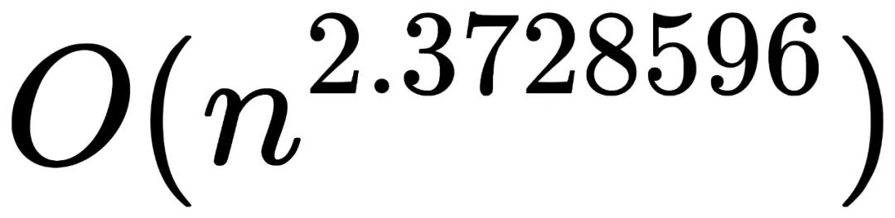
Complexity of Matrix Multiplication
Example: How many additions of integers and multiplications of integers are used by the matrix multiplication algorithm to multiply two n X n matrices.
Solution: There are n² entries in the product. Finding each entry requires n multiplications and n − 1 additions. Hence, n³ multiplications and n²(n − 1) additions are used.
Hence, the complexity of matrix multiplication is O(n³).
n阶矩阵乘法最优解的时间复杂度，目前达到

Slide 12
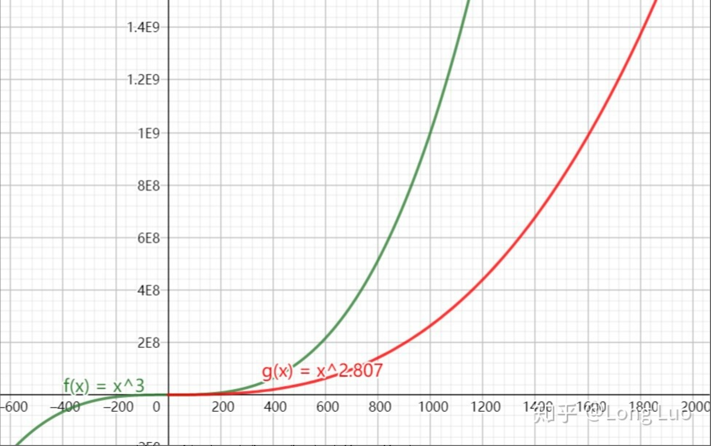
Complexity of Matrix Multiplication
Strassen算法
Coppersmith-Winograd方法, 2.375

Slide 13
Example
以计算 nXn 阶行列式为例子。
如果我们用行列式定义去计算，其计算复杂度为 O(n•n!)
如果我们通过行消元将行列式化上三角行列计算，其计算复杂度为 O(n⁴)
如果 n= 50,采用第一种方法所需要计算的乘法次数 1.5X10^{65，}第二种方法所需要的乘法次数为6X10⁶，如果用一台计算速度是每秒可执行1000亿次乘法的计算机计算，其计算时间分别为5x10⁴⁶年及6x10⁻⁵秒

Slide 14
* Understanding the complexity of algorithm
3.3 Complexity of Algorithms
Tractable（易解）: A problem is solvable using an algorithm with polynomial worst-case complexity.
Intractable（难解）: A problem cannot be solved using an algorithm with worst-case polynomial time complexity.
Solvable（可解）:
Unsolvable（不可解）: Some problems even exist for which it can be shown that no algorithm exists for solving them.
Halting problem: given a program and an input to the program, whether the program will eventually halt when run with that input.
K = { (i, x) | program i will eventually halt if run with input x}

Slide 15
* Understanding the complexity of algorithm
3.3 Complexity of Algorithms
Class P: tractable problems
Class NP (nondeterministic polynomial time): Solution can be checked in polynomial time. But no polynomial time algorithm has been found for finding a solution to problems in this class.
NP-complete: an important class of problems with the property that if any of these problems can be solved by a polynomial worst-case time algorithm, then all can be solved by polynomial worst-case time algorithms.
The satisfiability problem: the problem of determining if the variables of a given Boolean formula can be assigned in such a way as to make the formula evaluate to TRUE

Slide 16
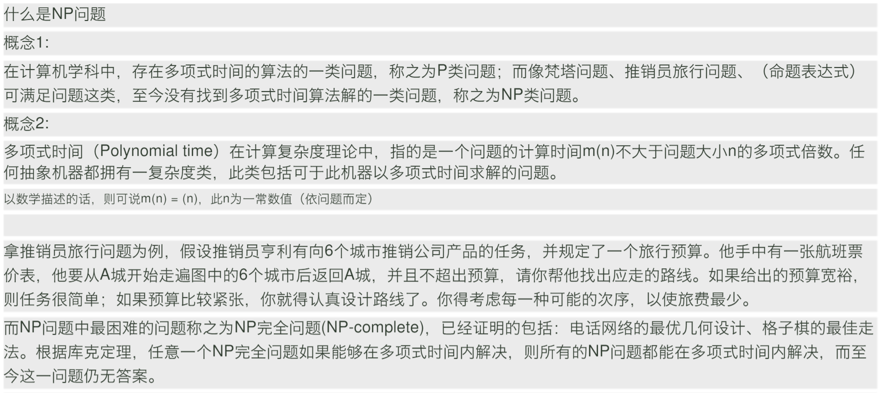
P就是能在多项式时间内解决的问题，NP就是能在多项式时间验证答案正确与否的问题。
P是否等于NP实质上就是在问，如果对于一个问题我能在多项式时间内验证其答案的正确性，那么我是否能在多项式时间内解决它？
NPC问题：NP中的某些问题的复杂性与整个类的复杂性相关联.这些问题中任何一个如果存在多项式时间的算法,那么所有NP问题都是多项式时间可解的.这些问题被称为NP-完全问题(NPC问题)。

Slide 17
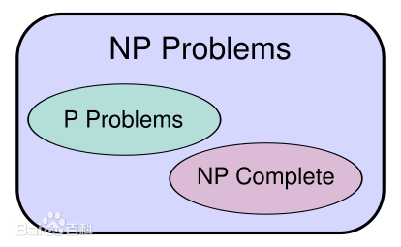
人们发现，所有的完全多项式非确定性问题（NP） ，都可以转换为一类叫做满足性问题的逻辑运算问题。
既然这类问题的所有可能答案，都可以在多项式时间内计算，人们于是就猜想，是否这类问题，存在一个确定性算法，可以在多项式时间内，直接算出或是搜寻出正确的答案呢（P）？
这就是著名的NP=P？的猜想。
假设P ≠ NP的图解。
若P = NP则三类相同。

Slide 18
Homework (Due on March 25)
Sec. 3.3 7, 10
7th, 8th
Notes:
https://blog.csdn.net/sinat_21591675/article/details/86521190?depth_1-utm_source=distribute.pc_relevant.none-task&utm_source=distribute.pc_relevant.none-task

Slide 19
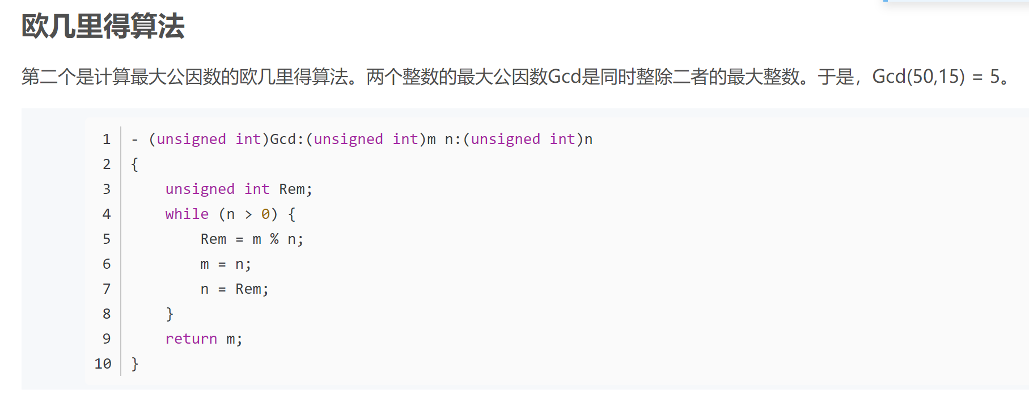
复杂度分析补充
对数复杂度
两次迭代最多是原始数据的一半，迭代次数至多是2logN。

Slide 20
复杂度分析补充
通常都是
有没有

Slide 21
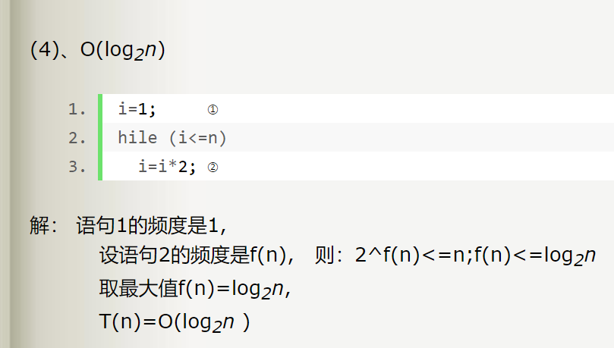
复杂度分析补充
对数复杂度

Slide 22
线性方程组求解：
Ax=b
1、Cramer’s rule
2、Gauss elimination

Slide 23
Boolean Product Algorithm
The definition of Boolean product of zero-one matrices can also be converted to an algorithm.
procedure Boolean product(A,B: zero-one matrices)
for i := 1 to m
for j := 1 to n
c_{ij} := 0
for q := 1 to k
c_{ij} := c_{ij} ∨ (a_{iq} ∧ b_{qj})
return C{C = [c_{ij}] is the Boolean product of A and B}

Slide 24
Complexity of Boolean Product Algorithm
Example: How many bit operations are used to find A ⊙ B, where A and B are n n zero-one matrices?
Solution: There are n² entries in the A ⊙ B. A total of n Ors and n ANDs are used to find each entry. Hence, each entry takes 2n bit operations. A total of 2n³ operations are used.
Therefore the complexity is O(n³)

Slide 25
Chapter 5 Induction and Recursion
(归纳与递归)
5.1 Mathematical Induction
5.2 Strong Induction and Well-Ordering
5.3 Recursive Definitions and Structural Induction
5.4 Recursive Algorithms

Slide 26
Homework (Due on March 25)
Sec. 5.1 46， 47， 48
Homework (Due on March 25)
Sec. 5.2 8, 18, 39

Slide 27
5.1 Mathematical Induction
1. Introduction
Mathematical induction is used to prove propositions of the form “nP(n), where the universe of discourse is the set of positive integers. (论域)
In this section we will discuss:
How can mathematical induction be used?
Why is mathematical induction valid?

Slide 28
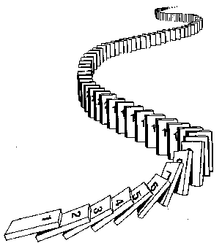
5.1 Mathematical Induction
Prove ∀ n P(n) by mathematical induction:
Basis step： Establish P(1)
Inductive step： Prove that P(k) → P(k+1) for k≥ 1
Conclusion: ∀ n P(n) , where the domain
is the set of positive integers

Slide 29
5.1 Mathematical Induction
2. Mathematical Induction
The (first) principle of Mathematical Induction
(P(1) ∧∀ k(P(k) → P(k+1))) →∀ n P(n)
The principle has the following form.
P(1)
∀ k P(k)→ P(k +1)
∴∀nP(n)

Slide 30
5.1 Mathematical Induction
〖Example 1〗 , where n is a positive integer
Proof:
Let P(n):
Basis step: P(1) is true because 1=1(1+1)/2
Inductive step: Assume P(k) holds for an arbitrary positive
Integer k. That is,
then
Therefore ∀ k P(k) → P(k+1) is true
By mathematical induction, ∀ n P(n) is true for all positive integer n

Slide 31
5.1 Mathematical Induction
〖Example 2〗Use mathematical induction to prove that
n < 2^{n} for all positive integers n.
Proof:
Let P(n): n < 2^{n}.
Basis step: P(1) is true because 1 < 2¹ = 2.
Inductive step: Assume P(k) holds for an arbitrary positive
Integer k, i.e., k < 2^{k}.
Since by the inductive hypothesis, k < 2^{k}, it follows that:
k + 1 < 2^{k} + 1 ≤ 2^{k} + 2^{k} = 2 ∙ 2^{k} = 2^{k+1}
Therefore ∀ k P(k) → P(k+1) is true
By mathematical induction, n < 2^{n} holds for all positive integers n.

Slide 32



〖Example 3〗Tiling Checkerboards. Show that every 2^{n} ×2^{n} checkerboard with one square removed can be tiled using right triominoes.
A right triomino is an L-shaped tile which covers three squares at a time.
Proof:
Let P(n) be the proposition that every 2^{n} ×2^{n} checkerboard with one
square removed can be tiled using right triominoes. Use mathematical
induction to prove that P(n) is true for all positive integers n.
BASIS STEP: P(1) is true, because each of the four 2 ×2
checkerboards with one square removed can be tiled using one
right triomino.
INDUCTIVE STEP: Assume that P(k) is true for every 2^{k} ×2^{k}
checkerboard, for some positive integer k.

Slide 33
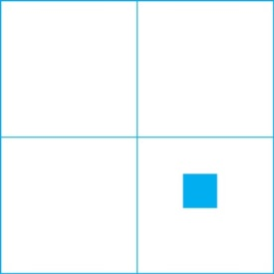
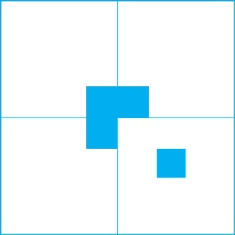
Proof:
Consider a 2^{k+1} ×2^{k+1} checkerboard with one square removed.
Split this checkerboard into four checkerboards of size 2^{k} ×2^{k},
by dividing it in half in both directions.
Remove a square from one of the four 2^{k} ×2^{k} checkerboards.
By the inductive hypothesis, this board can be tiled. Also by the
inductive hypothesis, the other three boards can be tiled with
the square from the corner of the center of the original board removed.
We can then cover the three adjacent squares with a triomino.
Hence, the entire 2^{k+1} ×2^{k+1} checkerboard with one square
removed can be tiled using right triominoes.
.

Slide 34
5.1 Mathematical Induction
The validity of mathematical induction follows from the well-ordering property for the set of positive integers.
A set S is well ordered if every nonempty subset of S has a least element.
For example,
N is well ordered
Z is not well ordered under the ≤ relation (Z has no smallest element).
(0, 1) is not well ordered since (0,1) does not have a least element.

Slide 35
5.1 Mathematical Induction
The well-ordering property
Every nonempty set of nonnegative integers has a
least element.

Slide 36
5.1 Mathematical Induction
P(1)
∀ k(P(k)→ P(k+1))
Why mathematical induction is valid?
∀nP(n)
Proof:
Assume that there is at least one positive integer for which P(n) is false.
S: the set of positive integer for which P(n) is false.
Then S is nonempty.
By the well-ordering property, S has a least element, which will be denoted by m.
Then m≠1, m-1 is a positive integer. m-1 is not in S. So P(m -1) is true.
Since the implication P(m-1)→ P(m ) is also true, P(m) must be true.
By contradiction, ∀nP(n)

Slide 37
5.1 Mathematical Induction
More general form
∀n ≥ b (P(n))
The procedure :
Basis step: Establish P(b)
Inductive step: Prove that P(k) → P(k+1) for k≥ b
Conclusion: The basis step and the inductive step
together imply ∀n ≥ b (P(n)) .

Slide 38
5.1 Mathematical Induction
〖Example 4〗Prove that if a set S has |S| = n, then |P(S)| = 2^{n}
Proof:
Let P(n): If |S| = n, then |P(S)| = 2^{n}
Basis step: P(0) is true because
S=ø, P(S) = {ø} and |P(S)| = 1 = 2⁰
Inductive step: Assume P(k): If |S| = k, then |P(S)| = 2^{k}
Prove that if |T| = k+1, then |P(T)| = 2^{k+1}
T= S U {a} for some S ⊂ T with |S| = k, and a ∈ T.
P(T) = {X | a ∈ X∧X-{a}⊆S } U {X | X ⊆S }
Equivalently, P(T) = {X | a ∈ X∧X-{a}⊆S } U P(S)
|P(T)| = |P(S)| + |P(S)| = 2 |P(S)| =2⋅2^{k} = 2^{k+1}
By mathematical induction, ∀ n P(n) is true for all nonnegative integers n

Slide 39
Homework (Due on March 25)
Sec. 5.1 46， 47， 48

Slide 40
Chapter 5 Induction and Recursion
5.1 Mathematical Induction
5.2 Strong Induction and Well-Ordering
5.3 Recursive Definitions and Structural Induction
5.4 Recursive Algorithms

Slide 41
5.2 Strong Induction and Well-ordering
1. Strong Induction
Strong Induction
(second principle of mathematical induction, complete induction)
(P(n₀)∧∀ k>=n₀(P(n₀)∧P(n₀+1)∧…∧P(k) → P(k+1)))→ ∀n>=n₀ (P(n))
The procedure :
Basis step: Establish P(n₀)
Inductive step: Prove P(n₀)∧P(n₀+1)∧ . . . ∧P(k) → P(k+1)
Conclusion: The basis step and the inductive step allow
one to conclude that ∀n≥n₀ P(n)

Slide 42
5.2 Strong Induction and Well-ordering
〖Example 1〗 Show that if n is an integer greater than 1, then n can be written as a prime or the product of primes.
Solution:
Let P(n) be “n can be written as a prime or the product of two or more primes”
(1) Basis step P(2) is true.
(2) Inductive step
Assume that P(j) is true for all positive integers j with j ≤ k. Show that P(k+1) is true under the assumption.
Proof by cases.
k+1 is prime P(k+1) is true.
k+1 is composite k+1=a×b, with 2≤ a ≤ b< k+1.
By the inductive hypothesis, k+1 is the product of primes, namely, those primes in the factorizations of a and b.
Therefore, ∀nP(n) by strong induction.

Slide 43
5.2 Strong Induction and Well-ordering
〖Example 2〗 Prove that every amount of postage of 12 cents or more can be formed using just 4-cent and 5-cent stamps.
Solution:
Let P(n) be “postage of n cents can be formed using 4-cent and 5-cent stamps.”
(1) Basis step P(12), P(13), P(14), and P(15) hold.
(2) Inductive step
Assume that P(j) is true for all positive integers j with 12 ≤ j ≤ k, where k ≥ 15. Show that P(k+1) is true under the assumption.
Using the inductive hypothesis, P(k − 3) holds since k − 3 ≥ 12. To form postage of k + 1 cents, add a 4-cent stamp to the postage for k − 3 cents.
Therefore, ∀n ≥ 12 P(n) by strong induction.

Slide 44
5.2 Strong Induction and Well-ordering
〖Example 2〗 Prove that every amount of postage of 12 cents or more can be formed using just 4-cent and 5-cent stamps.
Solution:
Let P(n) be “postage of n cents can be formed using 4-cent and 5-cent stamps.”
(1) Basis step: P(12) is true because postage of 12 cents can be formed using three 4-cent stamps.
(2) Inductive step: The inductive hypothesis P(k) for any positive integer k is that postage of k cents can be formed using 4-cent and 5-cent stamps. To show P(k + 1) where k ≥ 12 , we consider two cases:
If at least one 4-cent stamp has been used, then a 4-cent stamp can be replaced with a 5-cent stamp to yield a total of k + 1 cents.
Otherwise, no 4-cent stamp have been used and at least three 5-cent stamps were used. Three 5-cent stamps can be replaced by four 4-cent stamps to yield a total of k + 1 cents.
Therefore, ∀n ≥ 12 P(n) by mathematical induction.

Slide 45
5.2 Strong Induction and Well-ordering
Note:
The validities of both mathematical induction and strong induction follow from the well-ordering property.
In fact, mathematical induction, strong induction, and well-ordering are all equivalent principles.

Slide 46
5.2 Strong Induction and Well-ordering
2. Using Strong Induction in Computational Geometry
Some terms:
polygon
side, vertex
a polygon is simple
Every simple polygon divides the plane into two regions: its interior, its exterior.
convex, nonconvex
diagonal, interior diagonal
triangulation

Slide 47
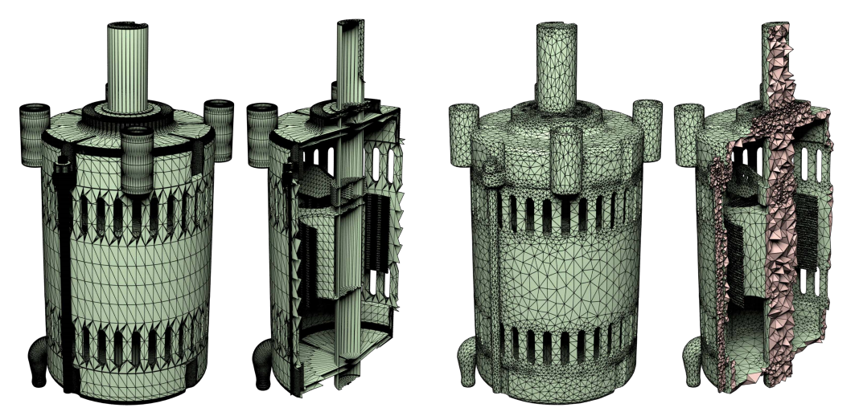
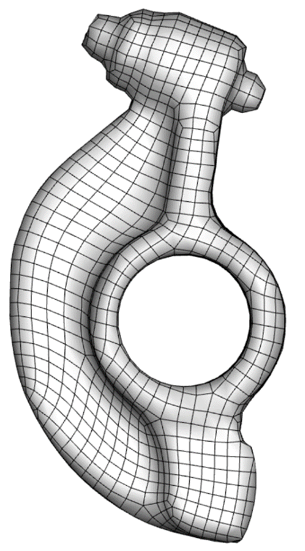
网格模型
是动画、3D视觉、工程仿真计算
面网格模型
四面体网格
六面体网格

Slide 48
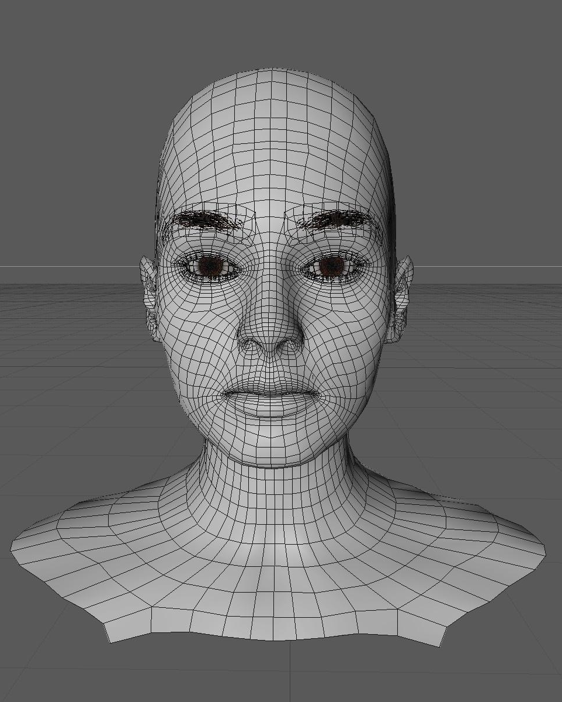
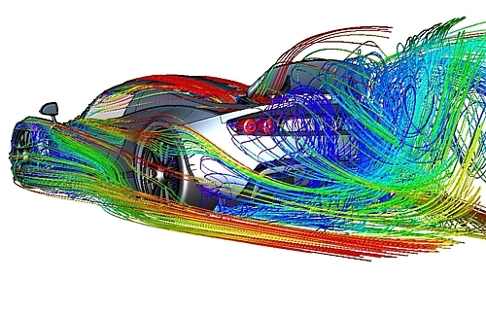
网格模型
物体表示：动画、电影、3D视觉
物理仿真：工程计算、有限元、
有限元仿真计算
物体离散表示

Slide 49
5.2 Strong Induction and Well-ordering
2. Using Strong Induction in Computational Geometry
【LEMMA 1】Every simple polygon has an interior
diagonal.

Slide 50
5.2 Strong Induction and Well-ordering
【Theorem 1】The simple polygon with n sides, where
n is an integer with n≥3, can be triangulated into n-2 triangles.
Proof:
Let T(n) be the statement that simple polygon with n sides can be
triangulated into n-2 triangles
(1) Inductive base T(3) is true.
(2) Inductive step
Assume that T(j) is true for all integers j with 3≤j ≤k. We must
show T(k+1) is true, that is that every simple polygon with k+1 sides
can be triangulated into k-1 triangles.
Suppose that we have a simple polygon P with k+1 sides.
By Lemma 1, P has an interior diagonal ab. ab splits P into two
simple polygon Q, with s (3≤s ≤k) sides, and R, with t (3≤t ≤k) sides.
(detail omitted.)
By strong induction, every simple polygon with n sides, where n ≥ 3, can be
Triangulated into n-2 triangles.

Slide 51
5.2 Strong Induction and Well-ordering
3. Proofs Using the Well-ordering property
〖Example 3〗 Use the well-ordering property to prove the division algorithm. The division algorithm states that if a is an integer and d is a positive integer, then there are unique integers q and r, with 0≤r<d such that a = dq + r.
Solution:
Let S be the set of nonnegative integers of the form a-dq, where q is an integer. This set is nonempty.
By the well-ordering property, S has a least element r=a-dq₀.
The integer r is nonnegative. It is also the case that r<d. If it were not, then there would be a smaller nonnegative element in S, namely, s=a-d(q₀.+1).
Consequently, there exist integers q and r with 0≤r<d.

Slide 52
5.2 Strong Induction and Well-ordering
〖Example 4〗 In a round-robin tournament every player plays every other player exactly once and each match has a winner and loser. We say that the players p₁, p₂, …, p_{m} form a cycle if p₁ beats p₂, p₂ beats p₃, …, p_{m-1} beats p_{m}, and p_{m} beats p₁. Using the well-ordering principle to show that if there is a cycle of length m (m≥3) among the players in a round-robin tournament, there must be a cycle of three of these player.

Slide 53
5.2 Strong Induction and Well-ordering
Solution:
Assume that there is no cycle of three players. Since there is at least one cycle in the round-robin tournament, the set of all positive integers n for which there is a cycle of length n is nonempty.
By the well-ordering property, this set of positive integers has a least element k, which by assumption must be greater than three. Consequently, there exists a cycle of players p1, p2, p3, …, p_{k} and no shorter cycle exists.
Consider the first three elements of this cycle, p1, p2, p3. There are two possible outcomes of the match between p1 and p3.
Case I: p3 beats p1
Case II: p1 beats p3
Either case forms a contradiction. Therefore there must be a cycle of length three.
Notes:
Cases 2 forms a shorter cycle

Slide 54
Homework (Due on March 25)
Sec. 5.2 8, 18, 39

